Slide 1
Hunterdon Preparatory
Iliana Diaz
Louie Vargas
Chelsie Ditzel

Slide 2
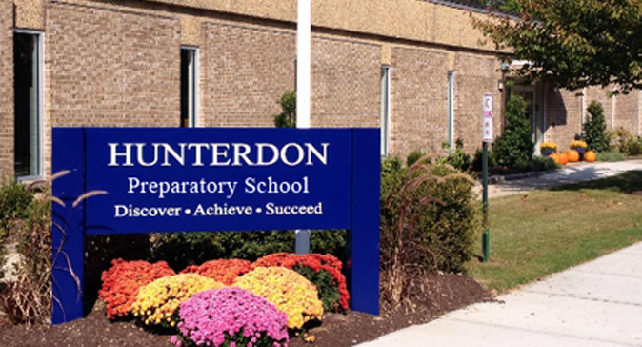
Hunterdon Preparatory
Mission Statement: Our program combines carefully designed counseling and social learning experiences with innovative academic instruction to promote social growth, behavioral change, and academic success. The school creates a supportive environment based on mutual respect and requires everyone to share responsibility for maintaining a healthy and safe learning community. Teachers, administrators and counselors work as a team to help students develop personal accountability and raise students' confidence in their ability to succeed.
Source: http://hunterdonprep.org/fundraisers/history-and-mission.html
Notes:
Add source for photo

Slide 3
Our Activity
Create a partnership between Raritan Valley Community College and Hunterdon Preparatory School so that students from Raritan Valley explore the field of education at Hunterdon Prep. This will not only give Raritan Valley students field experience but benefit the students of Hunterdon Prep as they will receive a more equitable education.

Slide 4
What We Learned About Teaching
Social emotional learning- group therapy three times per week
Differentiated instruction- all the students require different instruction. Each student working on different content and having different needs makes this very challenging for the teacher.
Problem based learning- Focused, experimental learning organized around the investigation and resolution of real world problems (Koch 117). Student internships

Slide 5
Our Role
To start the partnership between Raritan Valley and Hunterdon Prep School

Slide 6
What We Learned
Illiana: Teaching goes beyond teaching just content…
Chelsie: The diversity of the students and the importance of the role of the teacher.
Louie: The impact a teacher has on the students lives.

Slide 7
Most Memorable Events
Louie: “When I see you here it makes me so happy” Thanksgiving
Illiana: Halloween
Chelsie: the first day

Slide 8
Recommendations for Future Service Learning Experience
Professor Suk could enforce the service hours and be less accommodating
Let students know before the semester starts that the service hours are required for the course
Start service learning earlier

Slide 9
Additional Comments
It was love at first sight
Have an open mind
Give it 100% of your commitment
Perfect real life practice
Gives you the chance to see if teaching really is for you
How do you, the students feel having the opportunity to go to Hunterdon Prep?

