Slide 1
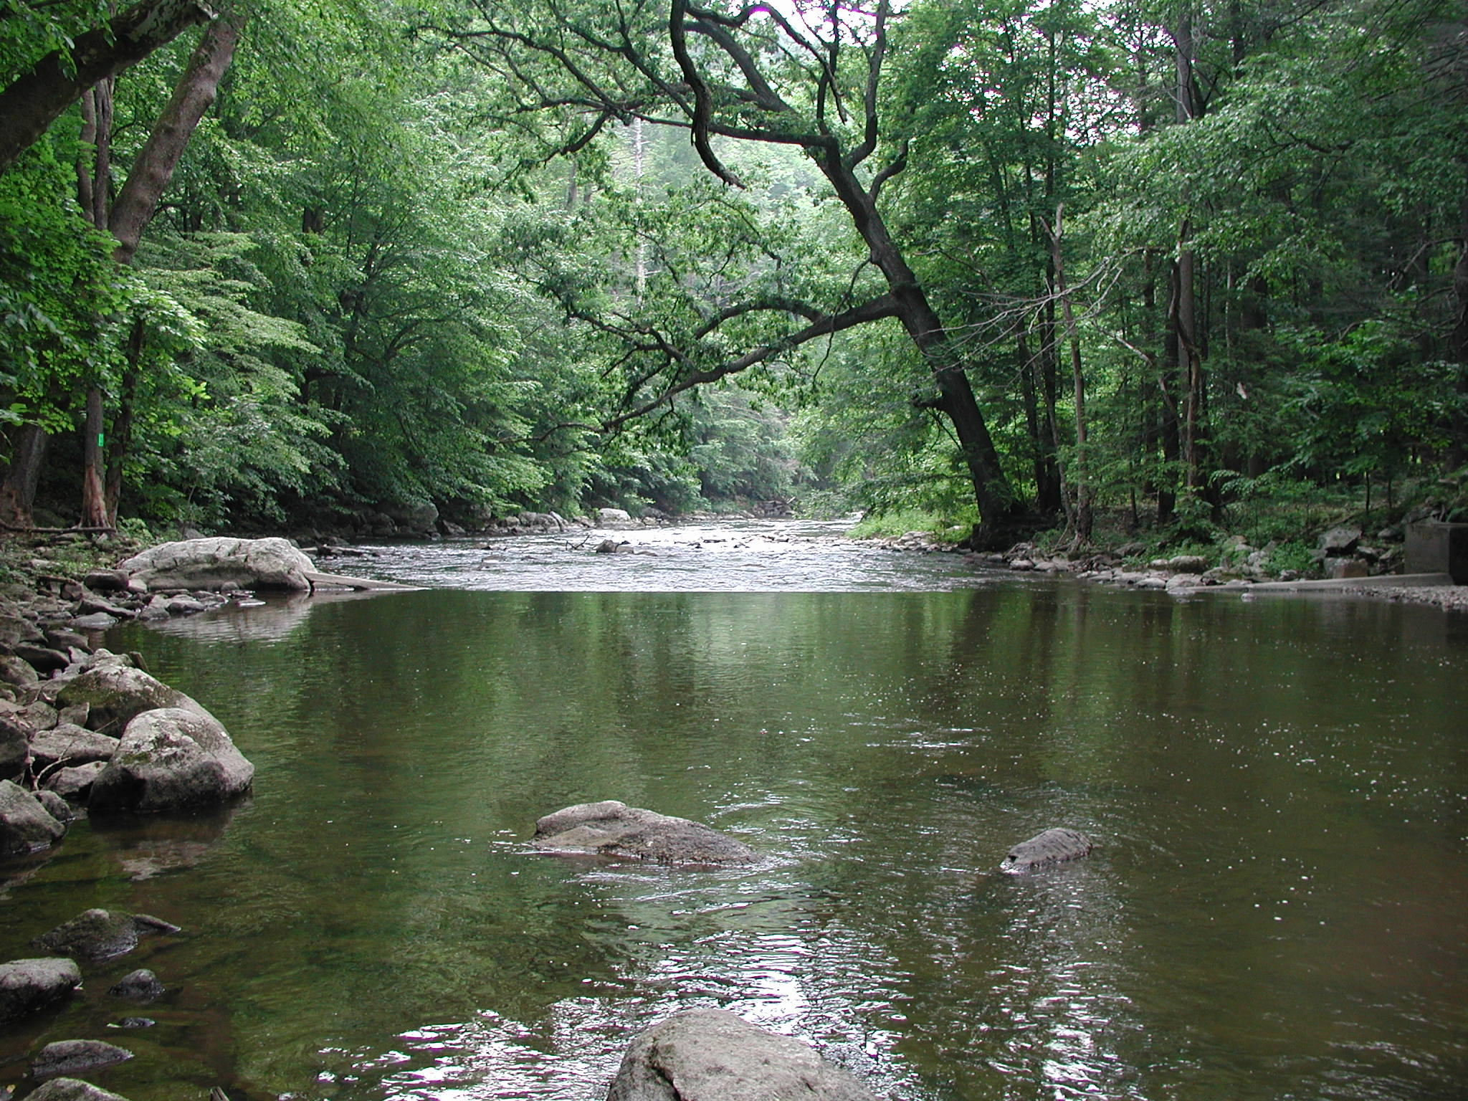
From Watershed to Woodlands
A Holistic approach to Environmental Science Education
Presented by Conrad A. Colon

Slide 2
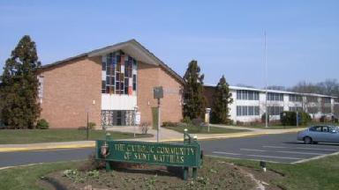
The School
St. Matthias Elementary School
Somerset, NJ
Grades K-8
~60 Students Per Class
Dedication to "Faith, Caring and Excellence"
http://tinyurl.com/jbo3kyn
http://www.stmatthias.info/logos/0-logo.png

Slide 3
The Project
Proposed by current 7th grade class
Raritan Headwaters Association Stream Cleanup of the Raritan River
Spring 2016
Community Effort

Slide 4
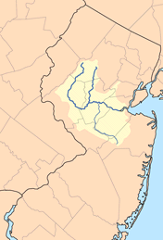
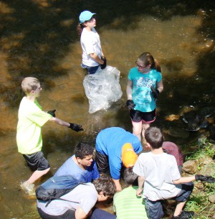
The River Shed & It’s Clean Up
1,100 square miles of land drained by the Raritan River
The size of Rhode Island.
dozens of rivers feeding into the basin
Immense human impact on system
http://tinyurl.com/zatlxad
http://tinyurl.com/jym4bby

Slide 5
Project Purpose:
To show students they have the ability to impact the world through environmental means, but present a program of study which would help provide a solid holistic foundation of knowledge for the understanding of local ecosystems.

Slide 6
The Educational Program
Woodland Wildlife Refuge
Foster an appreciation and understanding of New Jersey’s wildlife and habitats
Animals and Water
Firm educational base for project
http://tinyurl.com/zy5juws

Slide 7
Implementation of Program: Woodlands
Traveling Program
Flexible scheduling
Small cost to institution
Customizable time frame

Slide 8
Implementation of Program: RVCC
Strengthen a community connection
Interdisciplinary
Value to SMS Students
Values to RVCC Student
Low cost footprint
http://tinyurl.com/jlrbn4s

Slide 9
Implementation of Program: 3rd party program
Additional outside education program
Cost to institution
Implementation of Program: Curriculum integration
Builds a community aspect to the project
Course connections to areas such as weather and taxonomy

Slide 10
Foreseeable Impact
Student empowerment
Building real world solutions
Recognition of biodiversity
The Sharing of knowledge
The value of time

Slide 11
Sustainability
Creating a self-sustainable project
Peer Collaboration
Strengthen Peer-Peer bonds SMS has
http://tinyurl.com/hg7gcyw

Slide 12
http://tinyurl.com/gpdm8nq

